Slide 1
Working with Kafka in WSO2

Slide 2
What is Kafka
Apache Kafka is a distributed publish-subscribe messaging system and a robust queue that can handle a high volume of data and enables you to pass messages from one end-point to another.
Kafka is suitable for both offline and online message consumption.

Slide 3
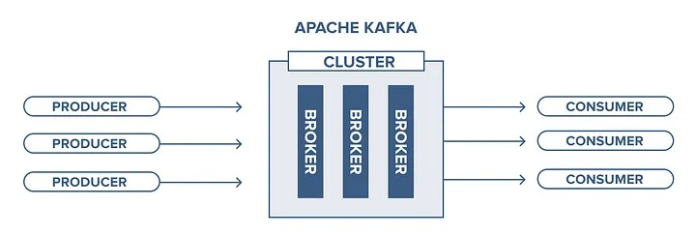
Kafka Architecture

Slide 4
Kafka Architecture
it’s just the act to send a message from one place to another. It has three principal actors:
Producer: Who produces and send the messages to one or more queues;
Queue: A buffer data structure, that receives (from the producers) and delivers messages (to the consumers) in a FIFO (First-In First-Out) way. When a message is delivered, it’s removed forever from the queue, there’s no chance to get it back;
Consumer: Who is subscribed to one or more queues and receives their messages when published.

Slide 5
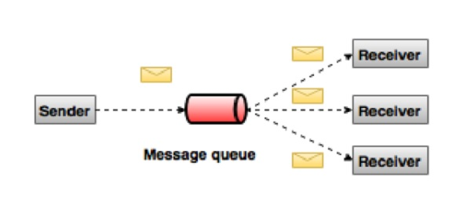
Working Of Kafka

Slide 6
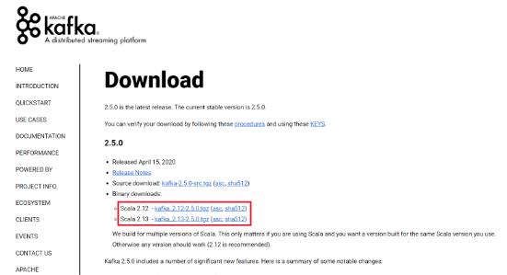
Download and Configuration
Apache Kafka can be downloaded from its Official site – kafka.apache.org
Extracted the binary file and move the extracted file to the directory where you need to deploy.

Slide 7
Download and Configuration
Copy the PATH of Kafka folder and go to the config file inside Kafka folder .Next open the zookeeper. properties file inside config .
Paste the path of Kafka in dataDir /zookeeper-data path
Similarly open the server.properties file inside config and paste the Kafka path to the log.dir and add /Kafka-logs to the path.

Slide 8
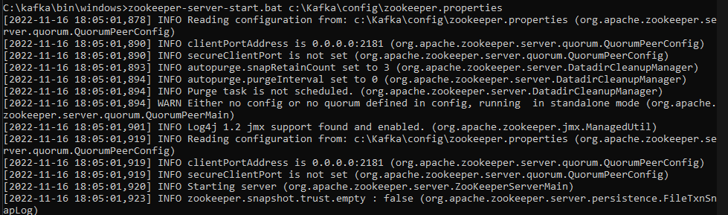
Run Kafka Servers
First start the zookeeper by using below command
C:\Kafka\bin\windows>zookeeper-server-start.bat c:\Kafka\config\zookeeper.properties

Slide 9
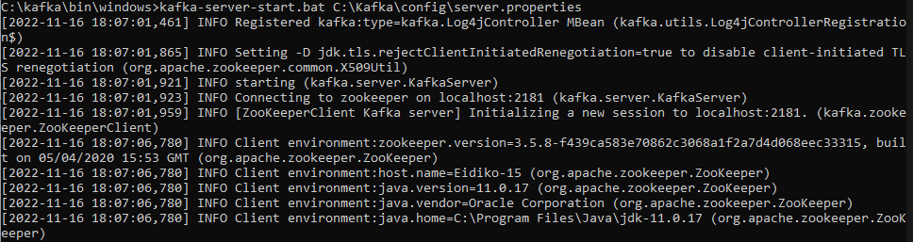
Run Kafka Servers
Now open another command prompt and change the directory to kafka/bin/windows and run the command given below
C:\Kafka\bin\windows>kafka-server-start.bat C:\Kafka\config\server.properties

Slide 10
Creating Kafka Topics :
kafka-topics.bat --create --bootstrap-server localhost:<port number> --replication-factor 1 --partitions 1 --topic <topic name>

Slide 11
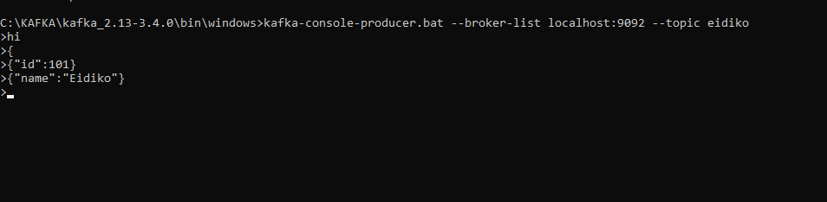
Publish Data to Kafka Console :
In order to sending data to console you need a Kafka Console Producer.
To write data inside topic run the below command
kafka-console-producer.bat --broker-list localhost:<port no> --topic <topic name>

Slide 12
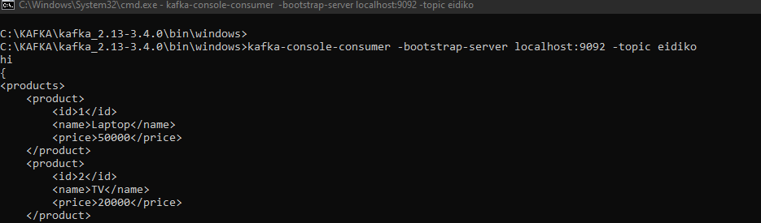
Kafka Console Consumer :
From Kafka path run the command given below
kafka-console-consumer -bootstrap-server localhost:<port no> -topic <topic name>

Slide 13
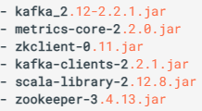
Kafka setup in WSO2 for Publish Message
To configure the Kafka connector, copy the following client libraries from the <KAFKA_HOME>/lib directory to the <ESB_HOME>/lib directory.

Slide 14
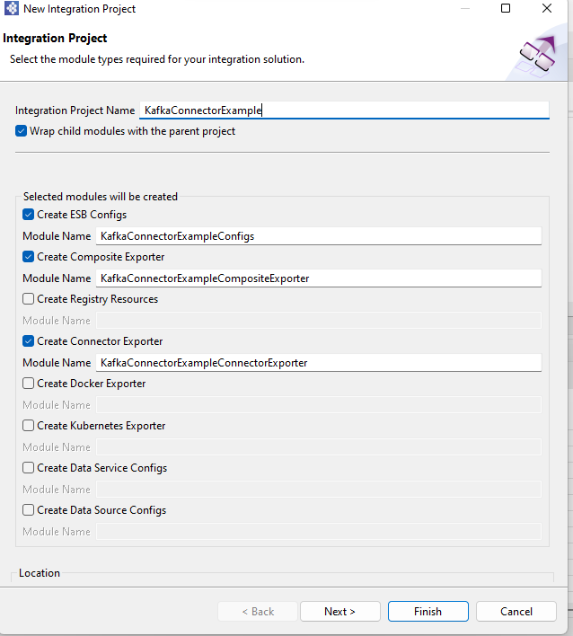
Kafka setup in WSO2 for Publish Message
Create Integration project and select ESB config, Composite Exporter and Connector Exporter.

Slide 15
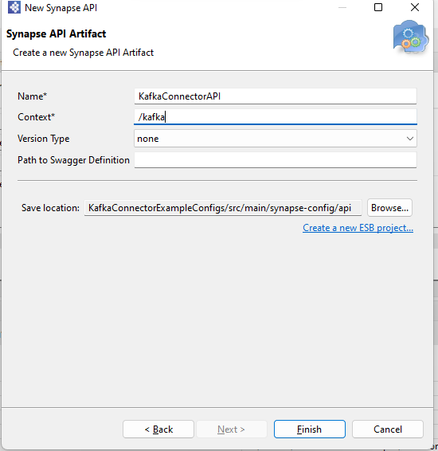
Kafka setup in WSO2 for Publish Message
Right click on API artefact in ESB Config and click new, select REST API.
Enter Name and context of API and click on next.

Slide 16
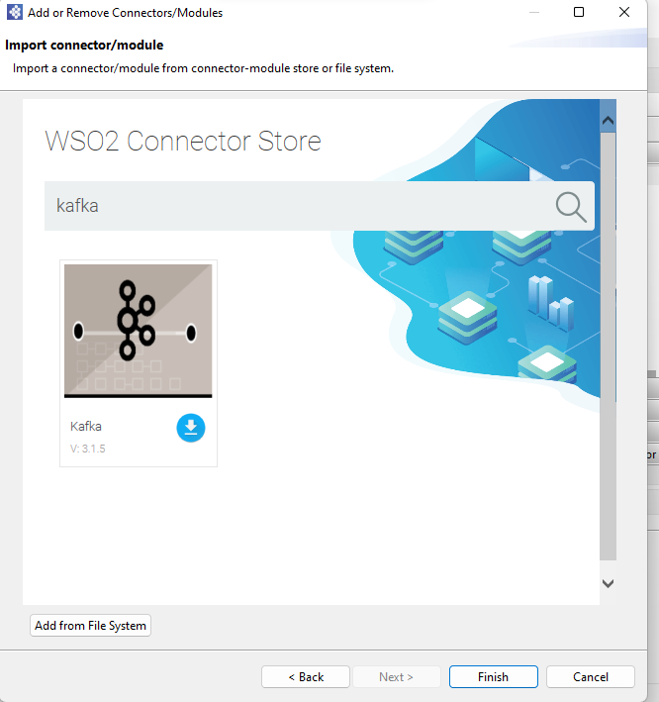
Kafka setup in WSO2 for Publish Message
Right Click on ESB Config and click on add/remove Connector
Search type the connector name in search box and click enter button and download connector using download button

Slide 17
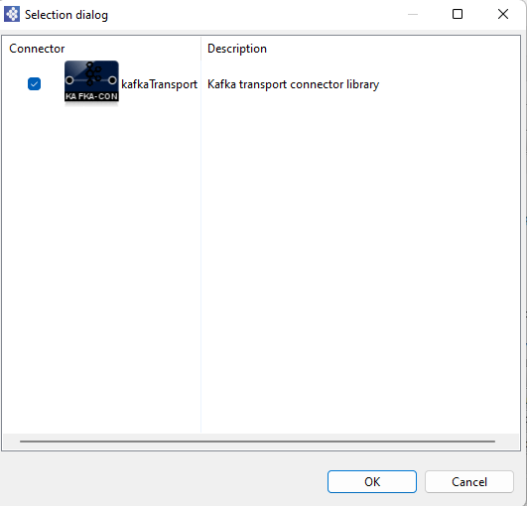
Kafka setup in WSO2 for Publishing Message
Right click on Connector Exporter and click on add/remove connector/module
Select connector (Kafka Connector) and click on ok

Slide 18
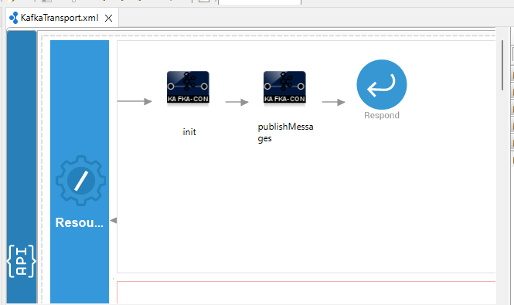
Kafka setup in WSO2 for Publish Message
From the Kafka Connector palette, click and drag a init and publishMessages Connector to the In sequence.
Init connector used configuration and publishMessage connector used to publish message.

Slide 19
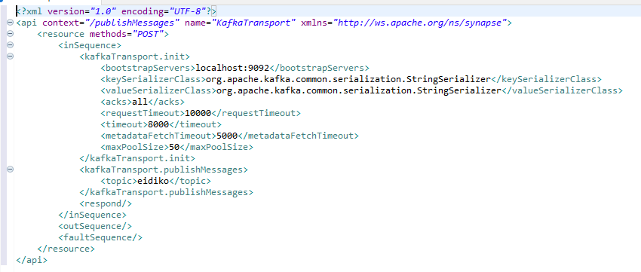
Kafka setup in WSO2 for Publish Message
Enter following details in init and publishMessage connector.

Slide 20
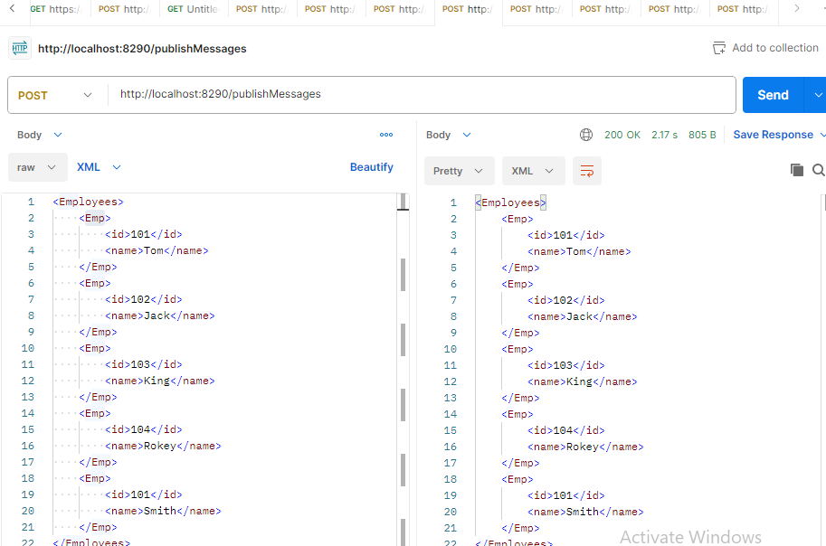
Test in Postman
Right click on the Project and configure the artifacts to the composite exporter and run it.
Through Postman send the request.

Slide 21
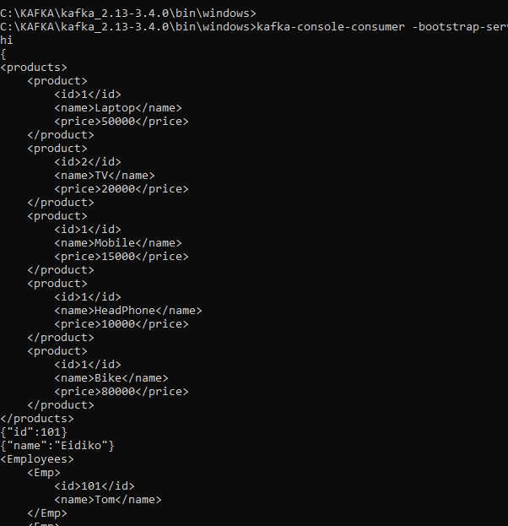
Test in Postman
Check message in Kafka consumer console

Slide 22
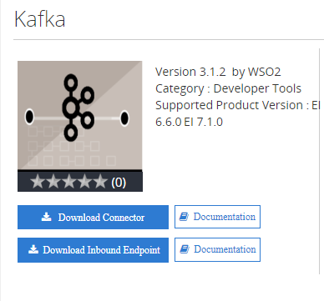
Kafka setup in WSO2 for Subscribe Message
Search WSO2 Store in browser open connector store then search for the required connector and click on download inbound endpoint
After downloading move the jar file in the <ESB_HOME>/lib directory.

Slide 23
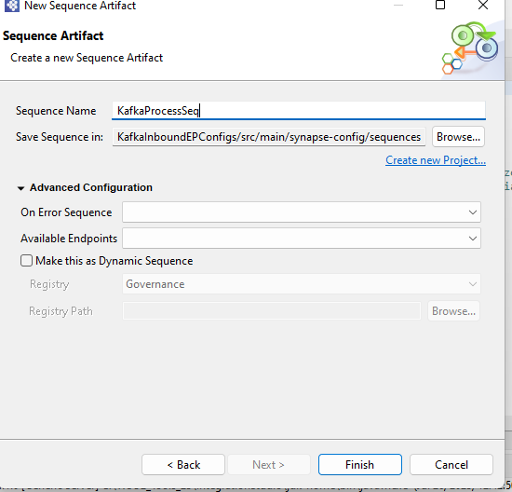
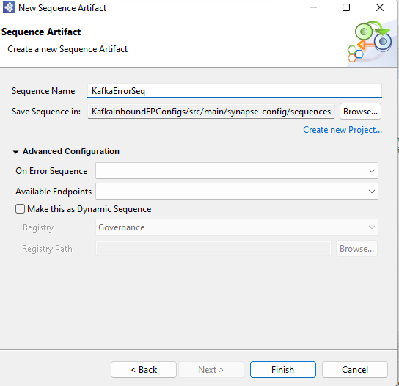
Kafka setup in WSO2 for Subscribe Message
Right click on Sequence artefact in ESB Config and click new, select Sequence .
Enter Name of Sequence and click on next.

Slide 24

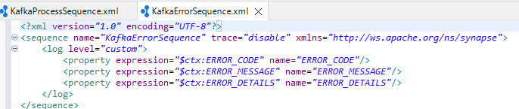
Kafka setup in WSO2 for Subscribe Message
From the Mediator palette, click and drag log Mediator to the In both sequence.
In process sequence select log level full.
In error sequence add following properties.

Slide 25
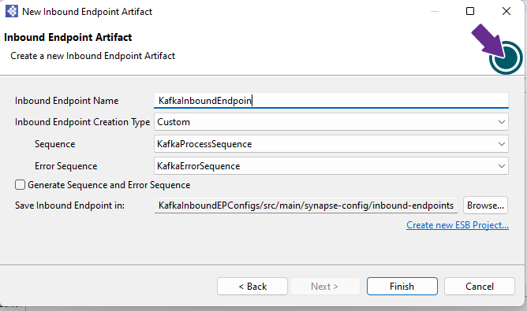
Kafka setup in WSO2 for Subscribe Message
Right click on Inbound Endpoint artefact in ESB Config and click new, select Inbound Endpoint.
Enter Name of Inbound Endpoint and click on next.
Select type, process and error sequence.

Slide 26
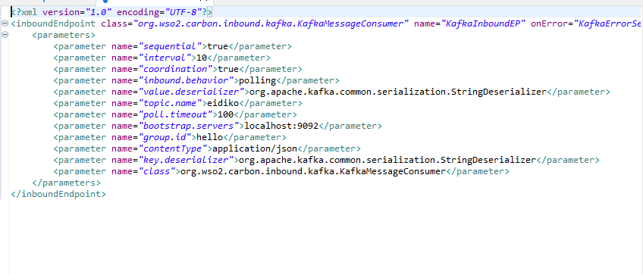
Kafka setup in WSO2 for Subscribe Message
Enter Following parameter and click on save.

Slide 27
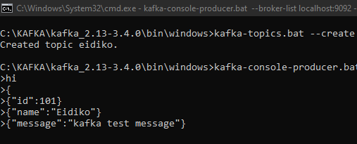
Test in Kafka producer console
Right click on the Project and configure the artifacts to the composite exporter and run it.
Write the message in Kafka producer console.

Slide 28
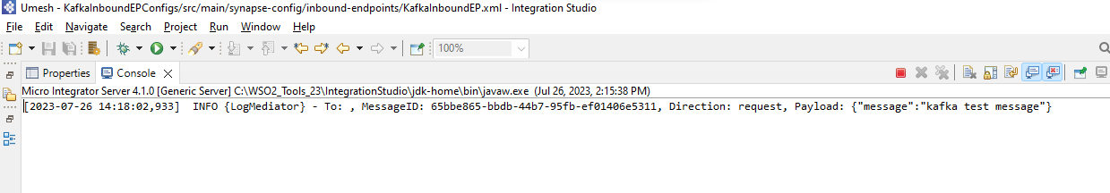
Test in Kafka producer console
Check message in WSO2 Integration studio console

Slide 29


